Slide 1

Injury Registration during Europe’s top-level events in the period 2005-2025
What is new in recent years ?

Slide 2
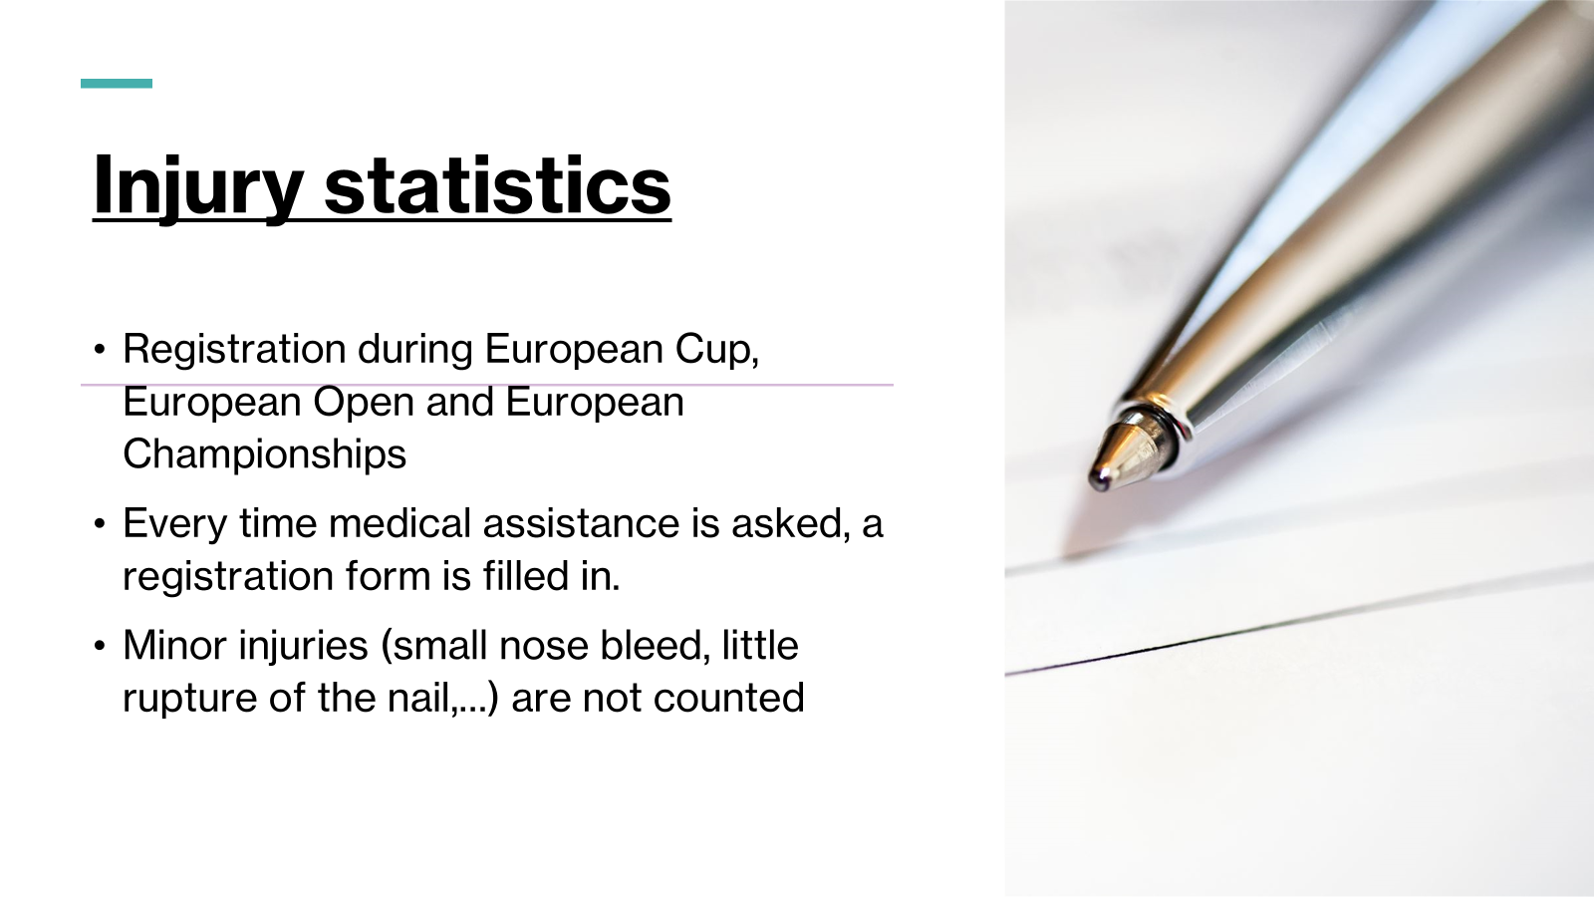

Slide 3

Total data (2004-2025)
Recent data over de period 2024-2025

Slide 4
Over the period 2005-2025
235 events
74676 participants
45511 men (60,9%)
29165 women (39,1%)

Slide 5
Over the period 2005-2025
1490 injuries
2,00% of all participants need medical intervention
0,41% of all participants were transported to hospital

Slide 6
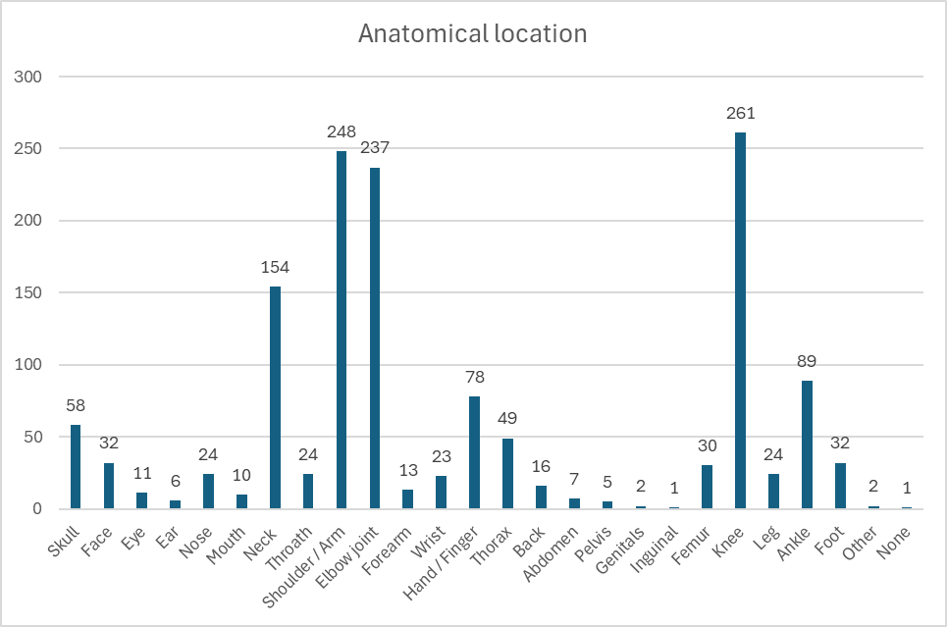
Anatomical location (2005-2025)

Slide 7

Anatomical location (2005-2025)

Slide 8
Type of injury (2005-2025)

Slide 9
Let’s take a look at the most recent data for the years 2024 and 2025

Slide 10
In 2024 and 2025
76 events
25632 participants
15687 men (61%)
9945 women (39%)
509 medical interventions
1,99% of all participants need medical intervention,
we saw 2,00% during the entire period

Slide 11
Serious injuries in 2024 en 2025
105 participants were transported to hospital, which is 0,41% of all participants
Exactly equal to the 0,41% we had in the total period.
Confirmation of the injury-incidence

Slide 12

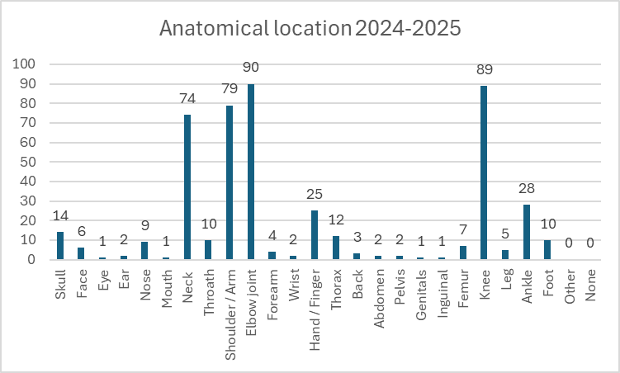
Comparision Anatomical location

Slide 13

Comparision Anatomical location

Slide 14
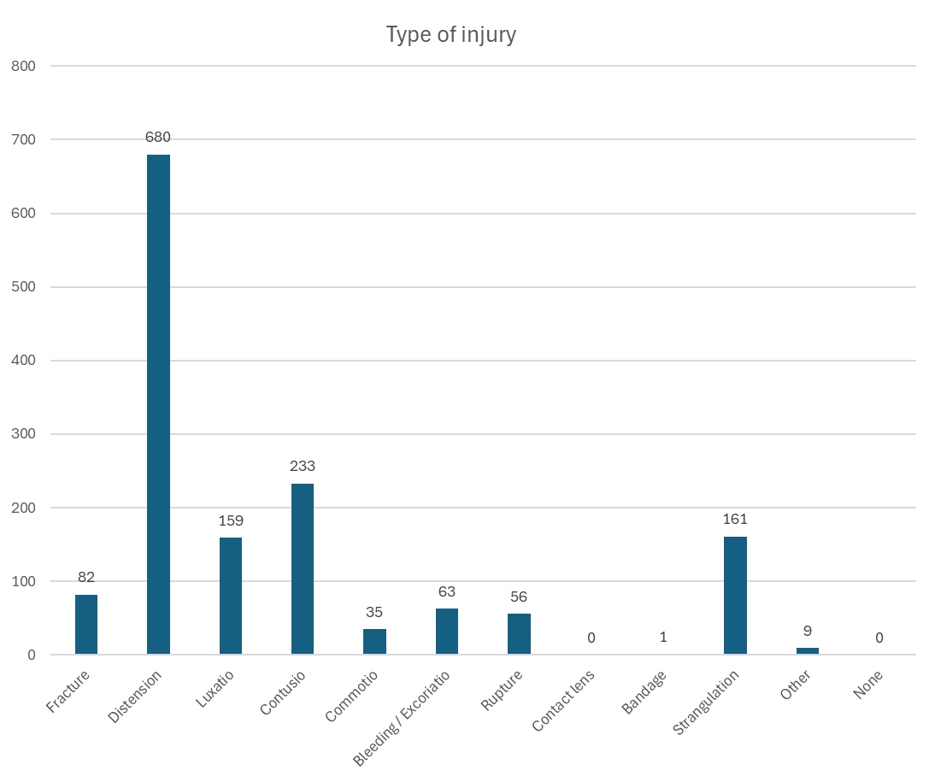
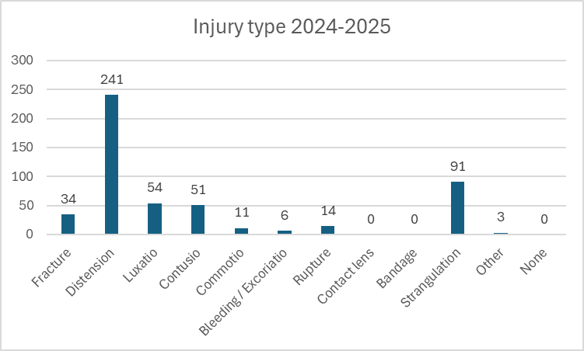
Comparision injury type

Slide 15

Comparision injury type

Slide 16
Unconsciousness after shime waza
During the total period of registration 10,8% of all interventions were for strangulation
In 2024 this went up to 16,3%
In 2025 even 18,7%

Slide 17
Unconsciousness after shime-waza
We estimate that :
In the period 2005-2023 there was an unconsciousness after shime waza every 714 matches
In 2024 : 1 unconsciousness every 456 matches
In 2025 : 1 unconciousness every 394 matches

Slide 18
A closer look at those strangulation-cases
38% women
62% men
Which is the same as the participation-rate
No difference men vs women

Slide 19
A closer look at those strangulation-cases
Women
Men

Slide 20
A closer look at those strangulation-cases
Nobody had to be transferred to hospital after unconsciousness due to shime-waza during the entire period 2005-2025
Nevertheless prevention is very important

Slide 21
We all had the subjective feeling that the incidence of unconsciousness was rising.
This is now confirmed by statistical data
Shouldn’t we act ?

Slide 22
What can we do ?
Would it be a good idea to extend the rule of the Cadets, that you can’t go to the repechage after unconsciousness, to all age categories ?
Can we start a prevention campaign to all concerned (judokas, coaches, medical personnel, referees,…)
How are the strangulation data in other continents and on the IJF-level ?

Slide 23

Thank you for your attention and of course all your comments and suggestions are very wellcome

